Slide 1
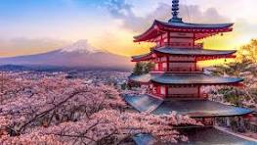
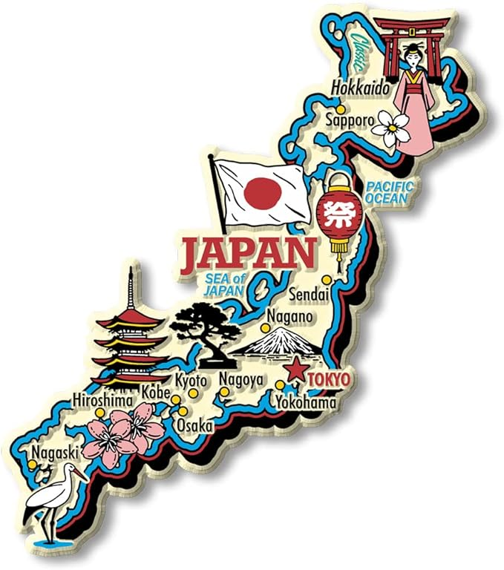
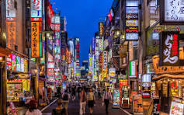
Snapshot – geography, history, context
Language
Culture
Food

Slide 2
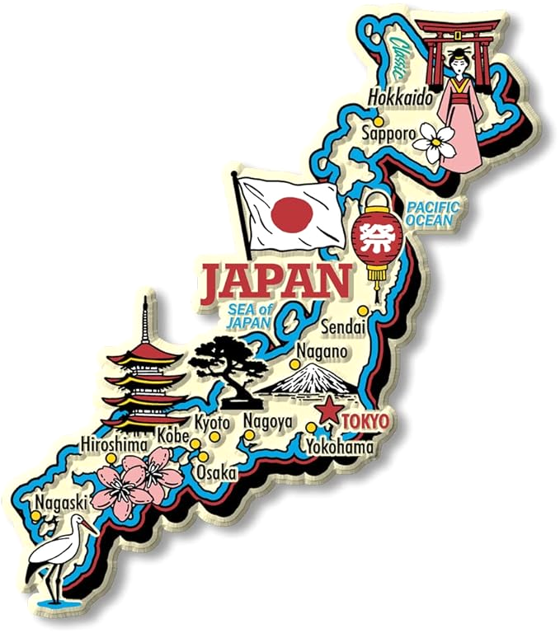
Snapshot – geography, history, context
Language
Culture
Food

Slide 3
Snapshot – geography, history, context
Language
Culture
Food

Slide 4
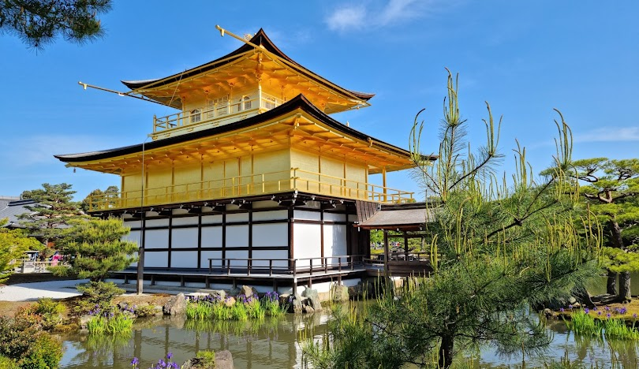
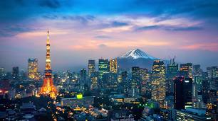
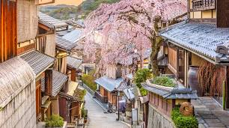
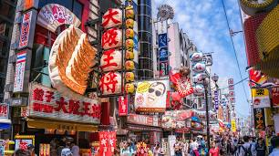
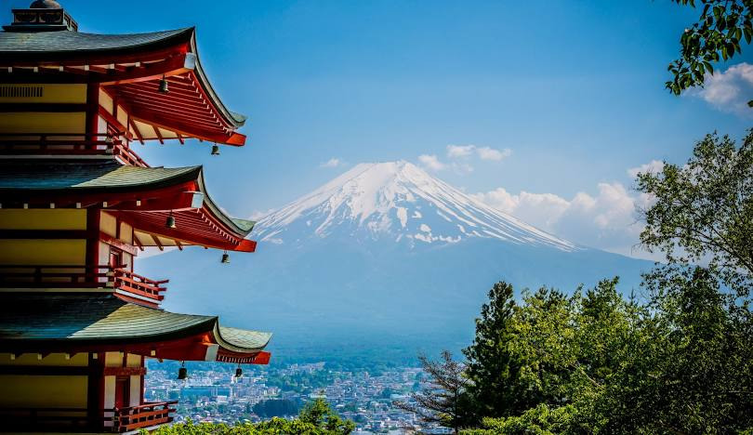
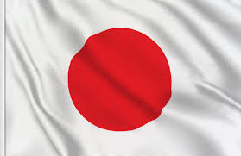

Slide 5
-Cherry blossom trees
--in Tokyo
--in Washington DC
-any other connectors like this?
--game of ‘where is this?’ or “is this Japan… or US?”
-how big and how small – Japan, korea, etc…
--prime ministers faces – who is this? Where are they from?
-Japan is four different islands, effectively
-kimono story and pictures – wedding kimono
-map with Japan in middle… vs. the map people typically see
-music – embed in deck
-Doraemon / etc. – embed a clip in deck – English and Japanese
-xx
-organize around questions that kids (or adults!) might have
-also make sure kids know they can ask questions throughout – and at end!
-do we have a take-home ‘package’ – chopsticks, Japan FAQs (or recommendations)?, what else?
Plan for the march day at Emi's class
What we will do today - Japan - snapshot of Japan today, history, culture, language, geography, food
Geography, snapshot of Japan today, history, etc. - Context of Japan in the world and region
Language - history.. hiragana, katakana, kanji
EMI can write her name in 3 ways in Japanese
Culture - anime, pokemon, doraemon, etc… and ORIGAMI
Practice origami
Food - sushi, etc… CHOPSTICKS, ONIGIRI
Learn to use chopsticks??
(MAYBE JUST SHOW THIS? OR HAVE SOME THAT THEY CAN PLAY WITH / EAT WITH THE CHOPSTICKS? OR HAVE EG EDAMAME with which kids can practice… then later they eat it with hands!)
Make onigiri
(Plus have some onigiri available for those who do not want to make onigiri)
(Things we need)
Onigiri ingredients - Shio-goma, nori-tama, salmon, nori, rice
Origami paper for the class demonstration / practice and to take home? (also a few big pieces to demonstrate at front of class)
Chopsticks
Pics of Emi and / or Irie in kimono
Images / videos as appropriate
Books or other things from Japan that are in Japanese but will otherwise be 'familiar' to kids - e.g. same story / kids book / etc.
Other?
(Things to demonstrate / illustrate)
Unique backgrounds and culture for everyone - we can learn and celebrate - but there are also a lot of similarities and common threads / interests that we can find across cultures and backgrounds - we can celebrate both!

Slide 7
Overview – Where in the world… and when?
Language – How many ‘letters’ are there?
Culture – Is there a Japanese Spiderman & Barbie?
Food – Does everyone in Japan like soy sauce?

Slide 8
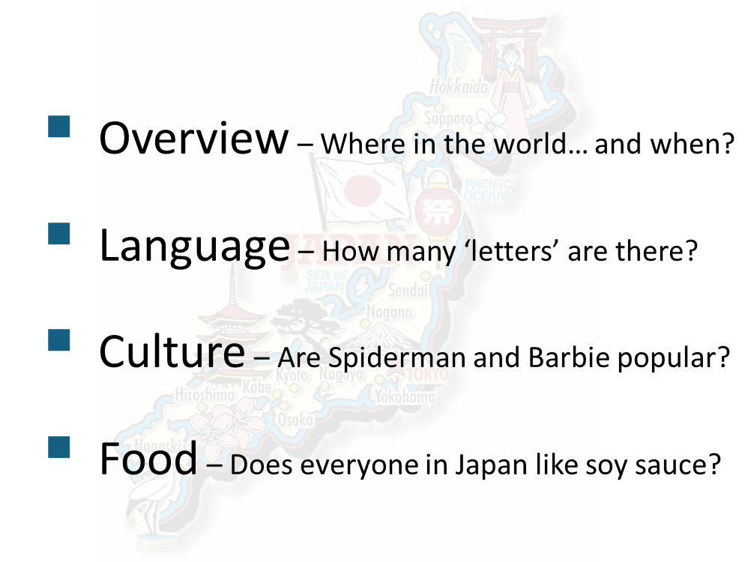
Overview – Where in the world… and when?
fix all slides
Where
-maps
-population
-context

Slide 9
Overview – Where in the world… and when?
When
-history
-timeline
-context

Slide 10
Language – How many letters are there?
3 character sets summary
-examples
-origin
-how many
-compare to usa – similarities, differences
-relate to everyday – when / how used (e.g. hmwk, signs, newspaper)

Slide 11
Language – How many letters are there?
Activity #1 – Emi’s name 3 ways

Slide 12
Culture – Is there a Japanese Superman and Barbie?
Overview
-answer the superman and barbie question
-anime
-sports
-compare jp and usa
-same as usa
-unique to / started in Japan – e.g. introduce origami

Slide 13
Culture – Is there a Japanese Superman and Barbie?
Activity #2 - origami

Slide 14
Food – Does everyone in Japan like soy sauce?
Overview
-answer the soy sauce question w/ stats
-importance of food to culture and family
-comparison between jp and usa
-example foods – some unique, some same
-introduce chopsticks and onigiri

Slide 15
Food – Does everyone in Japan like soy sauce?
Activity #3 – onigiri / chopsticks

Slide 16
-Cherry blossom trees
--in Tokyo
--in Washington DC
-any other connectors like this?
--game of ‘where is this?’ or “is this Japan… or US?”
-how big and how small – Japan, korea, etc…
--prime ministers faces – who is this? Where are they from?
-Japan is four different islands, effectively
-kimono story and pictures – wedding kimono
-map with Japan in middle… vs. the map people typically see
-music – embed in deck
-Doraemon / etc. – embed a clip in deck – English and Japanese
-xx
Plan for the march day at Emi's class
What we will do today - Japan - snapshot of Japan today, history, culture, language, geography, food
Geography, snapshot of Japan today, history, etc. - Context of Japan in the world and region
Language - history.. hiragana, katakana, kanji
EMI can write her name in 3 ways in Japanese
Culture - anime, pokemon, doraemon, etc… and ORIGAMI
Practice origami
Food - sushi, etc… CHOPSTICKS, ONIGIRI
Learn to use chopsticks??
(MAYBE JUST SHOW THIS? OR HAVE SOME THAT THEY CAN PLAY WITH / EAT WITH THE CHOPSTICKS? OR HAVE EG EDAMAME with which kids can practice… then later they eat it with hands!)
Make onigiri
(Plus have some onigiri available for those who do not want to make onigiri)
(Things we need)
Onigiri ingredients - Shio-goma, nori-tama, salmon, nori, rice
Origami paper for the class demonstration / practice and to take home? (also a few big pieces to demonstrate at front of class)
Chopsticks
Pics of Emi and / or Irie in kimono
Images / videos as appropriate
Books or other things from Japan that are in Japanese but will otherwise be 'familiar' to kids - e.g. same story / kids book / etc.
Other?
(Things to demonstrate / illustrate)
Unique backgrounds and culture for everyone - we can learn and celebrate - but there are also a lot of similarities and common threads / interests that we can find across cultures and backgrounds - we can celebrate both!

Slide 17
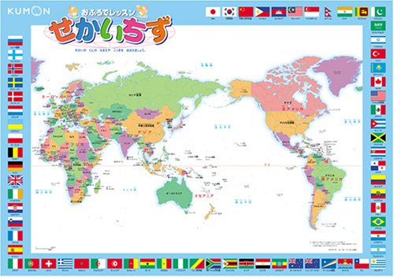
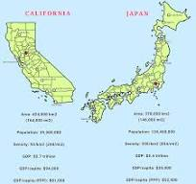
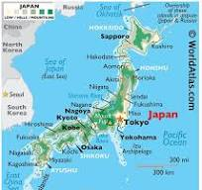
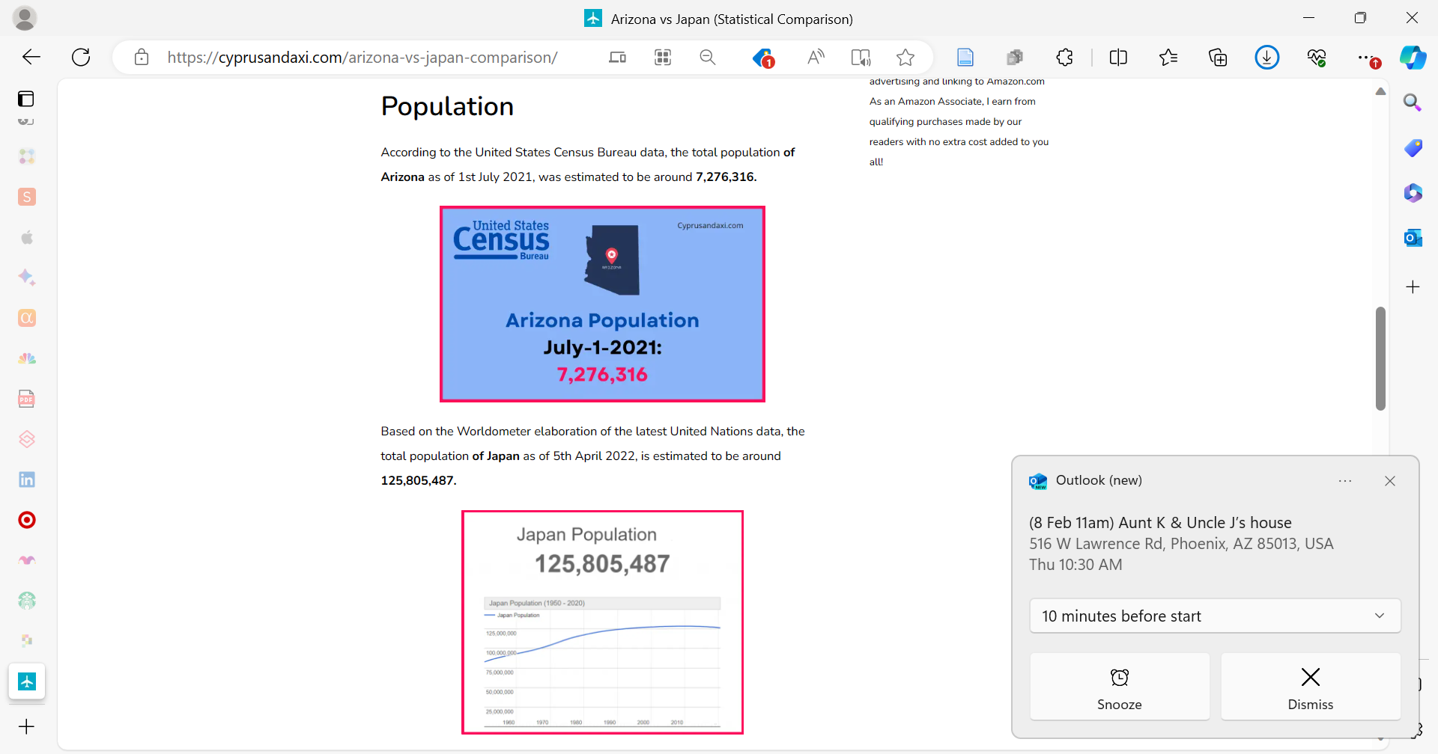
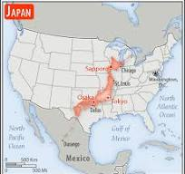
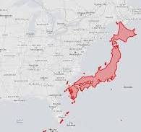
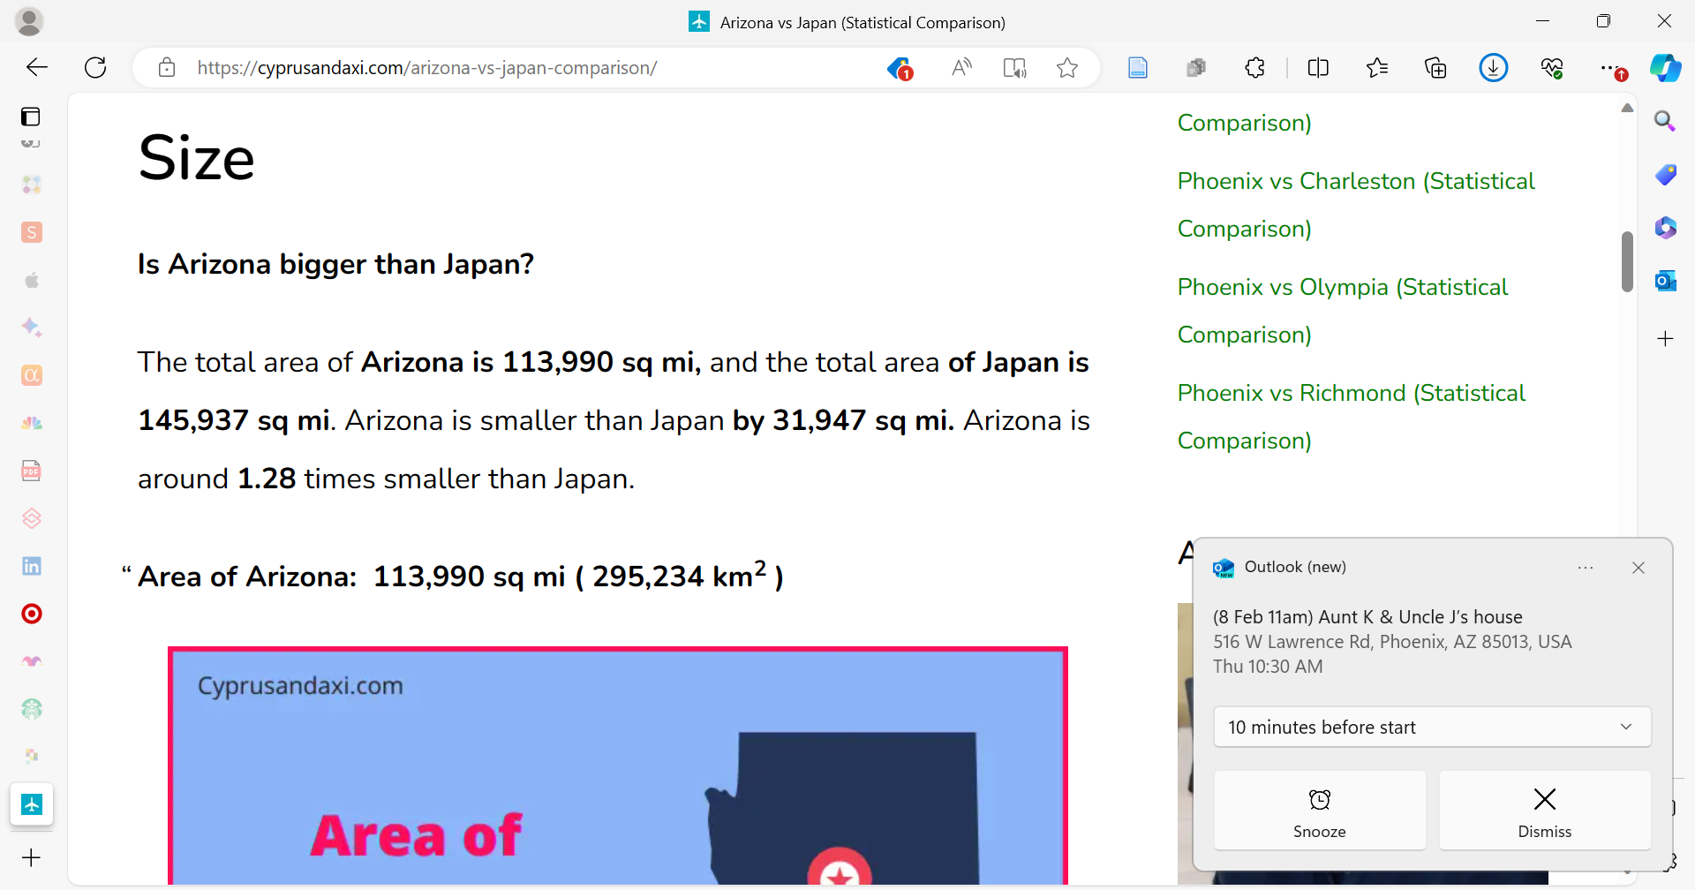
Arizona vs Japan (Statistical Comparison) (cyprusandaxi.com)

Slide 18
Timeline showing Japan history, broadly… and then also charting USA establishment for context.
-a cool visual? Showing the evolution of (whatever)

